Slide 1
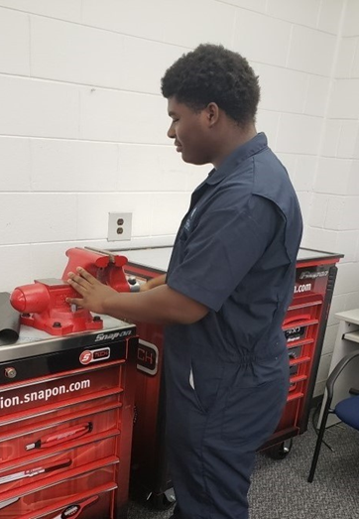
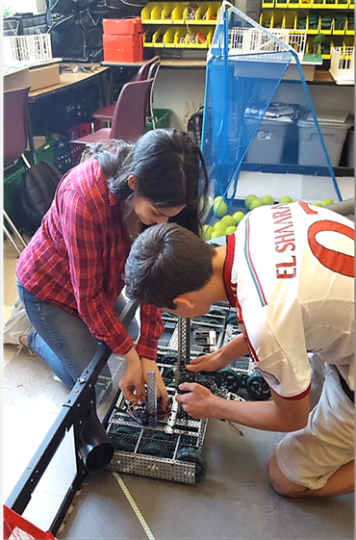
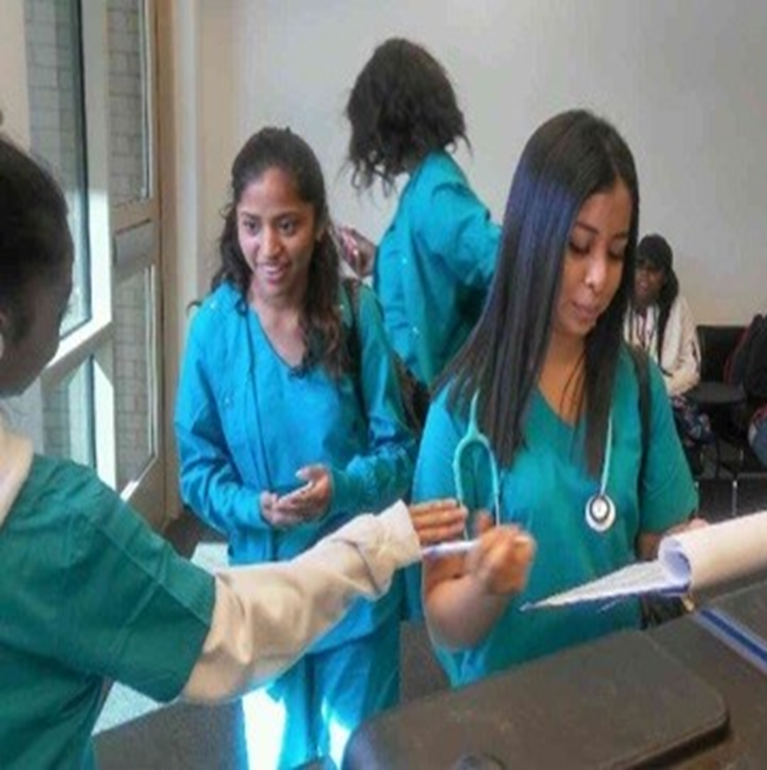
Virtual Open House
August 20, 2020
1 p.m.

Slide 2
Dr. Tasharah Wilson, Principal

Slide 3
Cybersecurity Pathway
Presenter:
Ms. Amber C. Williamson MISM, MNCM
3

Slide 4
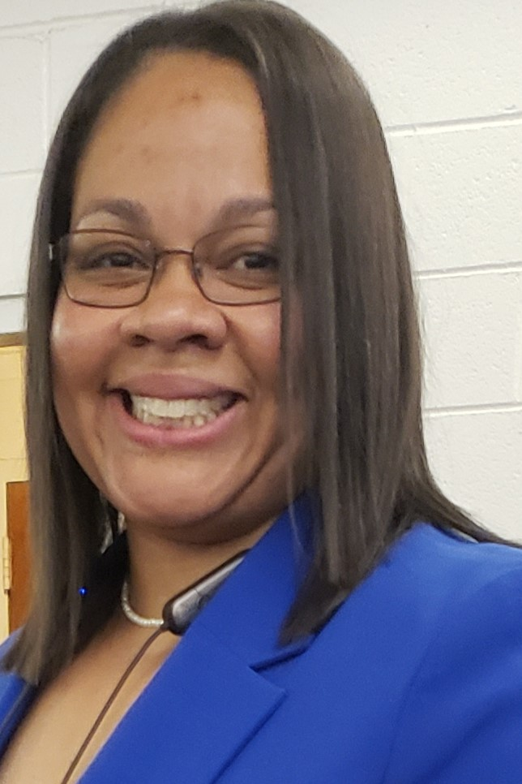
I’m excited to be your teacher!
15+ years of Industry and Educational Experience in IT and Cybersecurity.
BS Biology – Xavier University of Louisiana
BS Technical Management – DeVry University
Masters of Information Systems Management and Masters of Network Communications Management with Wireless Communication Concentration from Keller Graduate School of Management.
Starting Doctorate Program in Cybersecurity – Marymount University.
Professional Background: Non-Profit Computer Repairs, Technical Support, Field Engineer, Network Engineer, Cybersecurity Consulting Analyst.
What made you choose this field? Passion and Innovation

Slide 5
Exciting Facts about Cybersecurity

Slide 6
Exciting Facts about Cybersecurity Certifications

Slide 7
Exploration of Cybersecurity
What special projects will we complete?
What experiences will we have?
What will make this pathway exciting?
QOTD: How many of you want to make a salary between $50k-$60k out of High School and certified in Security+? Every student and even parent should be raising their hands!

Slide 8
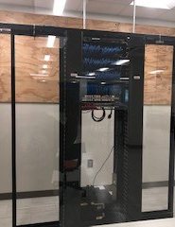
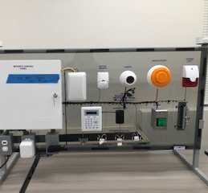
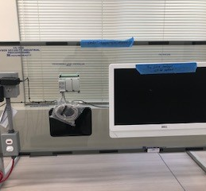
Exploring Our Lab
Here is our new classroom
See the tools and equipment that will be used.
Explain what they will do with the equipment.
Name some products/experiences that will be created.
What will students explore during the first course and continued pathway?

Slide 9
Instructional Expectations

Slide 10
ACCA Counselors

Slide 11
Questions

Slide 12
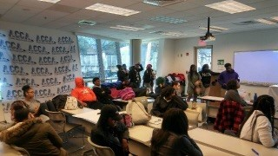
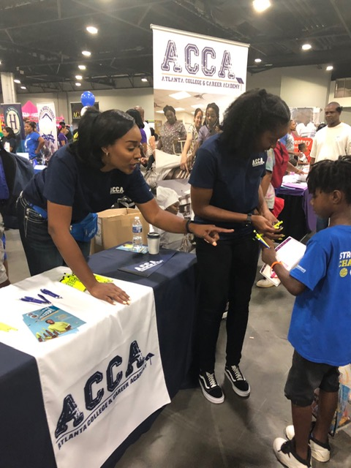
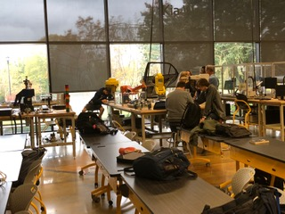
12

